Slide 1

Dr. J. J. Magdum College
of Engineering,
Jaysingpur
Department of
Computer Science & Engineering
2017-18

Slide 2
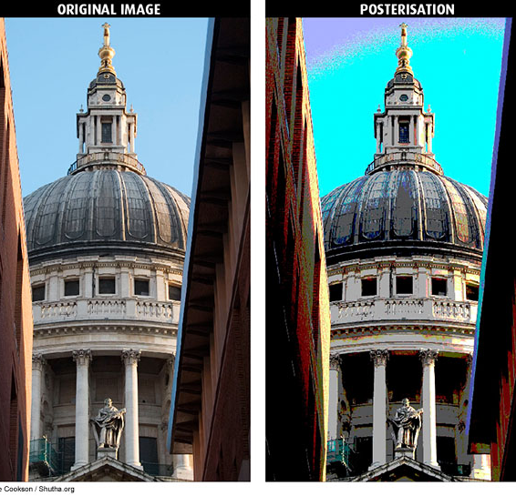
POSTERIZE
Project Guide:
Prof. P. R.Desai

Slide 3

PROJECT TEAM
Ashmita Dutta
Manasi Gawde
Komal Hodage
Pranav Harole

Slide 4







INDEX
Introduction
Algorithm
Functionality
Design & Diagrams
Function
Header Files
Requirements
Testing
Results
Conclusion
Reference

Slide 5
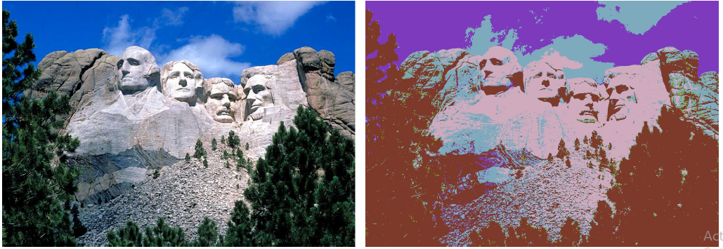
INTRODUCTION
The purpose of the project is to compute the minimum achievable sum of squared errors, given parameter k and a description of the red intensities of an image’s pixels and understand the concept of dynamic programming and recursion to find minimum optimal solution.

Slide 6

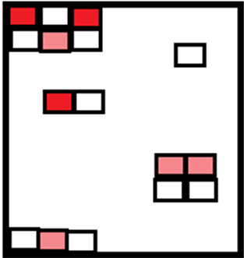
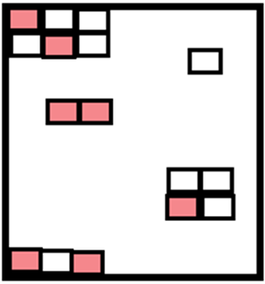
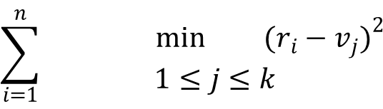
INTRODUCTION
$$\sum_{i=1}^{n}{\begin{aligned}\min{{(r_{i}−v_{j})}^{2}} \\ 1≤j≤k\end{aligned}}$$
The Sum of squared
errors in
Posterized image
Usage of Red intensity
value and pixels
Might be greater or less
Than its availability
In original image
Formula Used
Consider Matrix of 256*256
(i.e 1*1 represents 1 pixel of image)

Slide 7
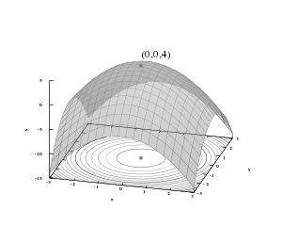

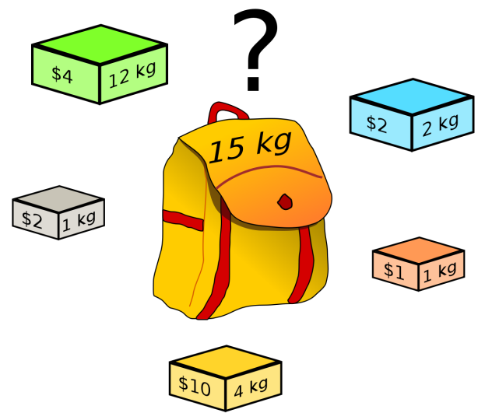
ALGORITHM
Dynamic programming
Knapsack
Algorithm
Travelling salesman

Slide 8


FUNCTIONALITY
Squared
Errors
Optimal
Solution
GUI
Accessibility
This module helps to calculate all the possible squared errors starting from the given red intensity
values in a assumed 256 * 256 matrix.
This module helps to find the optimal solution for the minimum squared errors using a recursive model.
No , special GUI functions were used in the program , but a simple loading function was used using sleep() and fflush() method .
The program shall provide an user friendly approach to enter the required inputs.

Slide 9
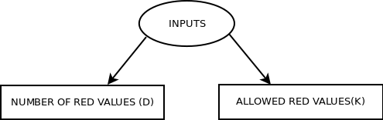
DFD Level 0

Slide 10
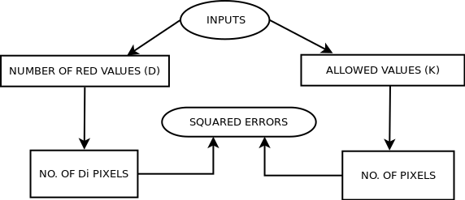
DFD Level 1

Slide 11
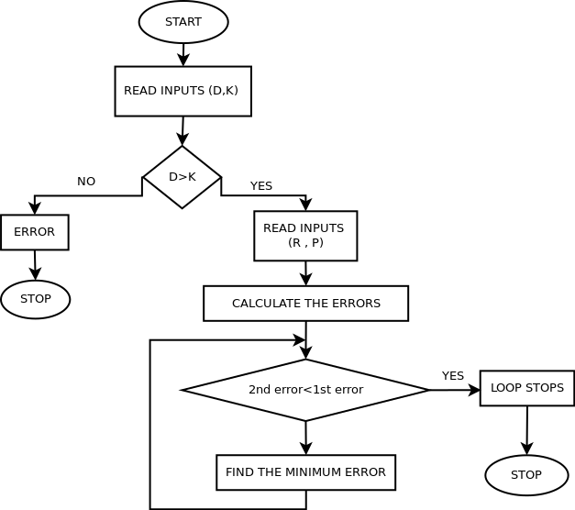
FLOW CHART

Slide 12
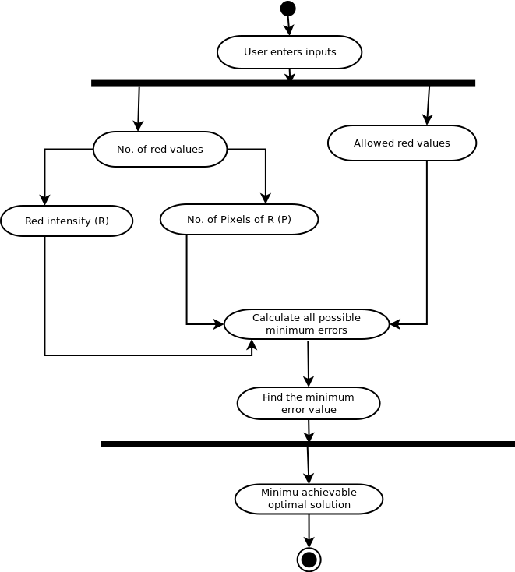
ACTIVITY DIAGRAM

Slide 13
FUNCTIONS
MODULES
memset()
min()
setw()
sizeof()
fflush()
Converts the value ch to unsigned char and copies it into each of the first count characters of the object pointed to
by dest.
It is used to find out the smallest of the number passed to it.
It is a compile –time operator that determines the size, in byte, of a variable or data type.
This function flushes any buffered data to the respective device.
It sets the number of characters to be used as the field width for the next insertion operation.

Slide 14
HEADER FILES
This header file is the code’s entry to various constant, type and function declarations that comprise the POSIX operating system API.
collection of functions especially designed to be used on ranges of elements that can be accessed through iterators or pointers.
algorithm
unistd.h
This header file streams to operate with physical devices like mouse , keyboard , etc.
It means input/output stream and is used for input output purposes.
stdio.h
iostream.h
This header file defines several functions to manipulate C strings and arrays.
This header file provides parametric manipulators.
cstring
iomanip

Slide 15







REQUIREMENTS

Slide 16
TESTING
Test Case-2
Test Case-1
2 1
50 20000
150 10000
4 2
0 30000
25 30000
50 30000
255 30000
Test Case-3
2 2
50 20000
150 10000
Output
37500000
Output
0
Output
66670000

Slide 17
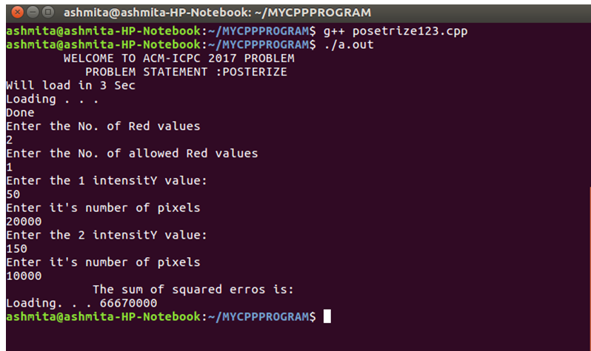
TESTING
Test Case-1
2 1
10 50000
20 30000
4 2
0 30000
25 30000
50 30000
255 30000
2 2
50 20000
150 10000
Output Test Case-1

Slide 18
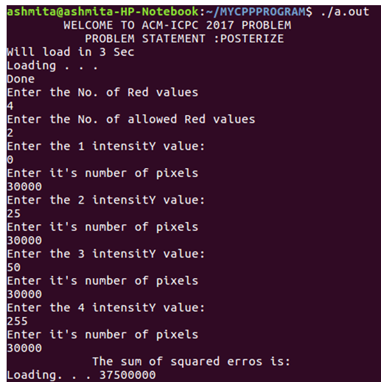
Output Test case-2

Slide 19
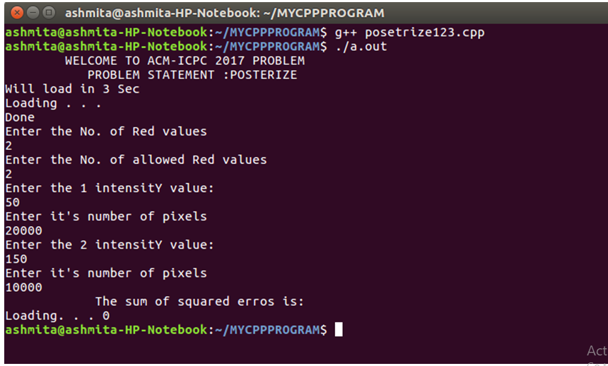
Output Test Case-3

Slide 20
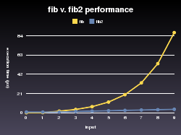
CONCLUSION
Our aim was to achieve this
solution through the application
of dynamic programming
and using recursive methods .
We believe that we have achieved
the requirement of the
problem statement.
The project design help to calculate
Pixel errors and to develop image editing
Application which have minimum errors.

Slide 21
REFERENCES
Books
ANSI C++ - E. BALAGURUSWAMY
OBJECT ORIENTED PROGRAMMING IN C++ - ROBERT LAFORE
LET US C++ - YASHWANT KANETKAR
INTEGRATED APPROACH TO SOFTWARE ENGINEERING –PANAJAK JALOTE
Website
https://www.geeksforgeeks.org/
https://www.codechef.com/wiki/tutorial-dynamic-programming

